Slide 1
Continuous Integration
Ben Miller & Rhianna Tomlinson

Slide 2
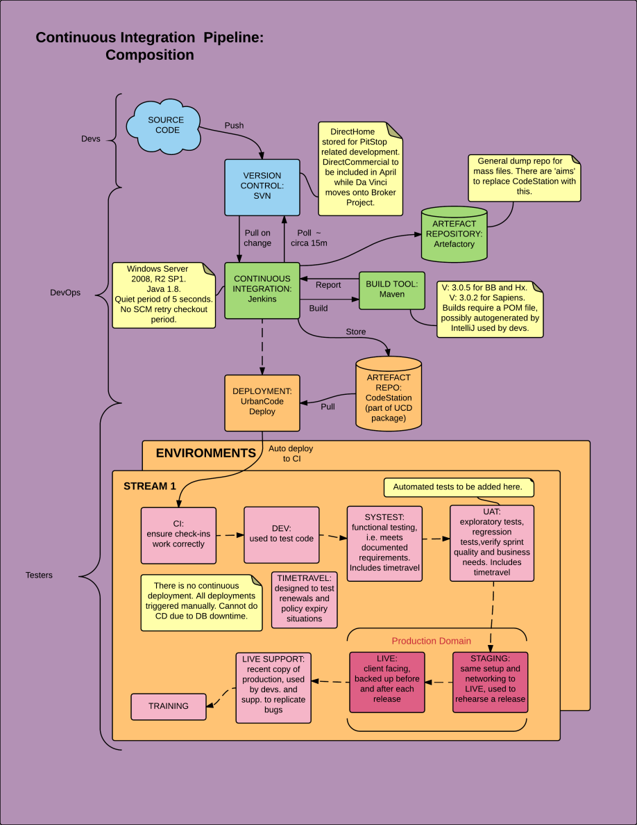
ORACLE
VERSION CONTROL:
Git
ARTIFACT REPOSITORY:
Nexus
CONTINUOUS INTEGRATION: Strider
DEPLOYMENT: MCollective
Notes:
Puppet provides meta data to Mcollective to avoid ridiculous naming conventions for hostnames because it is made by the same people
Maven is a software project management and comprehension tool
Use a broadcast paradigm for request distribution, meaning that one message only leaves the client and gets broadcast to all nodes. This ensures consistency.
Nexus allows you to proxy, collect, and manage your dependencies so that you are not constantly juggling a collection of JARs. It makes it easy to distribute your software.

